Slide 1

3.1 Data storage
Subtitle
Notes:
NOTE:
To change the image on this slide, select the picture and delete it. Then click the Pictures icon in the placeholder to insert your own image.

Slide 2
Content
3.1 Data types
3.2 Storing Numbers
3.3 Storing Text, Media, Image, Video

Slide 3
Objectives
After studying this chapter, the student should be able to:
List five different data types used in a computer.
Describe how integers are stored in a computer.
Describe how reals are stored in a computer.
Describe how text is stored in a computer using one of the various encoding systems.
Describe how audio is stored in a computer using sampling, quantization and encoding.
Describe how images are stored in a computer using raster and vector graphics schemes.
Describe how video is stored in a computer as a representation of images changing in time.

Slide 4
1-Data Types

Slide 5
1- Introduction
Data today comes in different forms including numbers, text, audio, image and video.
Figure -3.1 Types of data types

Slide 6
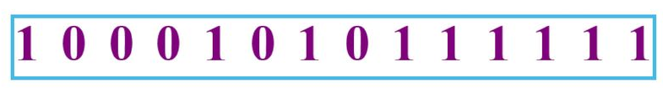
2. Data Inside the Computer
All data types are transformed into a uniform representation when they are stored in a computer and transformed back to their original form when retrieved.
This universal representation is called a bit pattern or a sequence of 0s and 1s.
Figure -3.2 A bit pattern
Bits (binary digit) : The symbol 0 or 1 is called a bit (binary digit), the smallest unit of data that can be stored in a computer.
Bits patterns a sequence, or a string of bits. A bit patterns with 8 bits is called a byte
Notes:
Bit : đơn vị lưu trữ dữ liệu nhỏ nhất
1 byte ( 1 word ) = 8 bit
Bit pattern : choỗi các bit

Slide 7
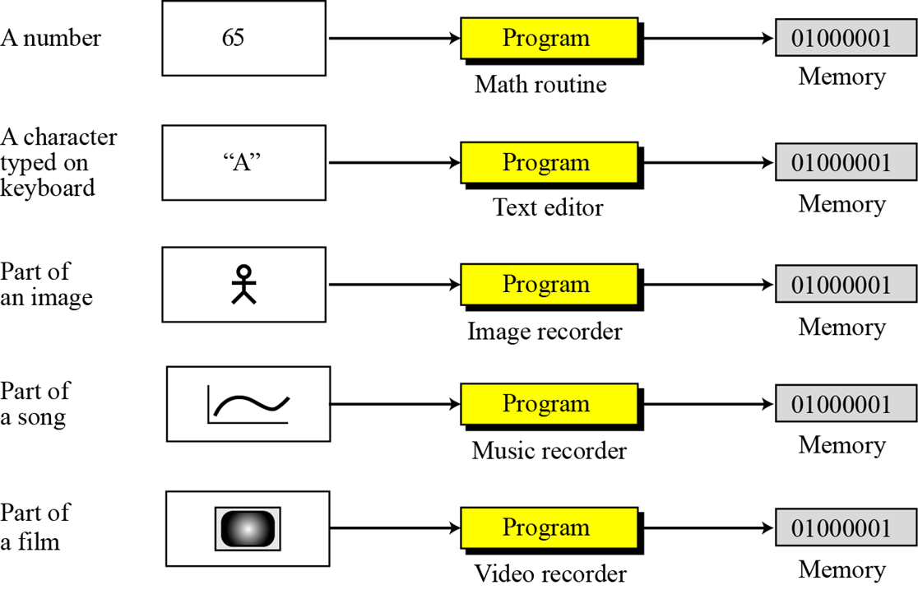
3. Storage of Different Data Types
Notes:
Mặc dù hình thức lưu trữ khác nhau nhưng kết quả giống nhau

Slide 8
2 - Storing Numbers

Slide 9
1. Introduction
A number is changed to the binary system before being stored in the computer memory, as described in Chapter 2. However, there are still two issues that need to be handled:
1. How to store the sign of the number.
2. How to show the decimal point.
There are several ways to handle the sign issue, discussed later in this chapter. For the decimal point, computers use two different representations: fixed-point and floating point.
The first is used to store a number as an integer—without a fractional part, the second is used to store a number as a real—with a fractional part.
Notes:
Fixed-pointed : dấu chấm cố đinh . Dùng cho số nguyên
Floating point : dấu phẩy động . Dùng cho số thực, số hữu tỉ ( có phần thập phân )

Slide 10
2. Storing Integers
Integers are whole numbers (numbers without a fractional part).
For example, 134 and −125 are integers, whereas 134.23 and −0.235 are not.
An integer can be thought of as a number in which the position of the decimal point is fixed: the decimal point is to the right of the least significant (rightmost) bit.
For this reason, fixed-point representation is used to store an integer, as shown below.
Notes:
Số nguyên có thể đc biểu diễn ở số thập phân với dấu chấm cố định ( Fixed point ) , khi đó Decimal point = Fixed point

Slide 11
Unsigned Representation
An unsigned integer is an integer that can never be negative and can take only 0 or positive values. Its range is between 0 and positive infinity. An input device stores an unsigned integer using the following steps:
1. The integer is changed to binary.
2. If the number of bits is less than n, 0s are added to the left
Example 3.1 Store 7 in an 8-bit memory location using unsigned representation.
Solution
First change the integer 7 to binary, => (111)_{2.}
Add five 0s to make a total of eight bits, (00000111)₂ . The integer is stored in the memory location.
Notes:
Unsigned interger : biểu diễn số nguyên không dấu
Vd store 5
Step 1: 5 -> binary : (101)₂
(00000111)₂
*** Dù lưu số nhỏ hay lớn vẫn là 8 bit ***
Vd Store 17 :
Step1: 17 -> (10001)₂
=> (00010001)₂

Slide 12
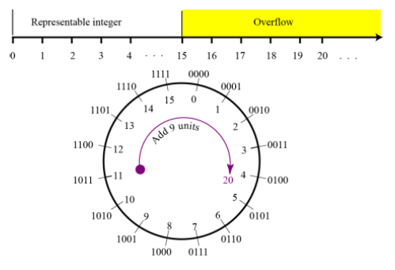
Overflow in unsigned integers
What happens if we try to store an integer that is larger than 2⁴ − 1 = 15 in a memory location that can only hold 4bits.
Notes:
Bộ nhớ 4 bit => lưu trữ tối đa 2⁴

Slide 13
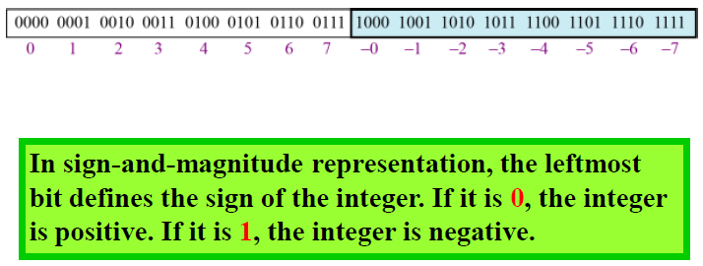
Sign-and-Magnitude Representation
In this method, the available range for unsigned integers (0 to 2n−1) is divided into two equal sub-ranges. The first half represents positive integers, the second half, negative integers.
Noted that there are two different representations for zero.
Notes:
Chưa rõ

Slide 14
Overflow in sign-and-magnitude representation
Both positive and negative overflow when storing an integer in sign-and-magnitude representation using a 4-bit memory location.
Notes:
Chưa rõ

Slide 15
Two’s Complementing
The second operation is called two’s complementing or taking the two’s complement of an integer in binary. This operation is done in two steps.
First, we copy bits from the right until a 1 is copied; then, we flip the rest of the bits.
Example 3.10 The following shows how we take the two’s complement of the integer 00110100.
Notes:
Bù 2: Chuyển Binary dương -> âm

Slide 16
Overflow in two’s complement representation
Notes:
Chưa rõ

Slide 17
Storing Reals
A real is a number with an integral part and a fractional part.
For example, 23.7 is a real number—the integral part is 27 and the fractional part is 7/10.
Although a fixed-point representation can be used to represent a real number, the result may not be accurate or it may not have the required precision. The next two examples explain why.
Example 3.1
In the decimal system, assume that we use a fixed-point representation with two digits at the right of the decimal point and fourteen digits at the left of the decimal point, for a total of sixteen digits.
The precision of a real number in this system is lost if we try to represent a decimal number such as 1.00234: the system stores the number as 1.00.

Slide 18
Floating-Point Representation for a Real number
The solution for maintaining accuracy or precision is to use floating-point representation.
A floating point representation of a number is made up of three parts: a sign, a shifter and a fixed-point number.
Example 3.2 The following shows the decimal number 7,425,000,000,000,000,000,000.00 in scientific notation (floating-point representation).
Notes:
1 Con số sử dụng Floating point bao gồm :
A sign : dấu , shifter : độ phóng/rộng , fixed-point number : dấu phẩy động

Slide 19
3 - Storing Text, Media, Image, Video

Slide 20
3.1 Storing Text
A section of text in any language is a sequence of symbols used to represent an idea in that language.
For example, the English language uses 26 symbols (A, B, C,…, Z) to represent uppercase letters, 26 symbols (a, b, c, …, z) to represent lowercase letters, nine (ten)symbols (0, 1, 2, …, 9) to represent numeric characters and symbols (., ?, :, ; , …, !) to represent punctuation.
Other symbols such as blank, newline, and tab are used for text alignment and readability.
Representing symbols using bit patterns
We can represent each symbol with a bit pattern. In other words, text such as “CATS”, which is made up from 4 symbols, can be represented as four n-bit patterns, each pattern defining a single symbol.
Notes:
Mỗi kí tự đc mã hóa thành 1 byte ( = 8bits )
Punctuation : chấm câu , text align : xếp text theo chiều ngang

Slide 21
Codes
ASCII (American Standard Code of Information Interchange):
ASCII: Using 7 bits for each symbol
Extended ASCII: Using 8 bits for each symbol
Using 32 bits to represent up to 232 symbols (including graphical and special symbols).
Unicode is suitable for the communication in multiple languages. ASCII and extended ASCII are parts of Unicode.
Other Codes

Slide 22
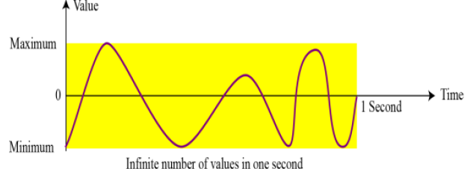
3.2 Storing Audio
Audio is a representation of sound or music. Audio is not countable. Audio is an example of analog data. Even if we are able to measure all its values in a period of time, we cannot store these in the computer’s memory, as we would need an infinite number of memory locations. Audio varies with time.
Figure -3.3 an example of analog data

Slide 23
Sampling
If we cannot record all the values of an audio signal over an interval, we can record some of them. Sampling means that we select only a finite number of points on the analog signal, measure their values, and record them.
Figure -3.4 an example of sampling

Slide 24
Quantization
The value measured for each sample is a real number. This means that we can store 40,000 real values for each one second sample. However, it is simpler to use an unsigned integer (a bit pattern) for each sample.
Quantization refers to a process that rounds the value of a sample to the closest integer value.
For example, if the real value is 17.2, it can be rounded down to 17: if the value is 17.7, it can be rounded up to 18.
Notes:
Lượng tử hóa : Quá trình xấp xỉ đại lượng => tang tốc thời gian xử lý các mô hình

Slide 25
Encoding
The quantized sample values need to be encoded as bit patterns. Some systems assign positive and negative values to samples, some just shift the curve to the positive part and assign only positive values.
If we call the bit depth or number of bits per sample B, the number of samples per second, S, we need to store S × B bits for each second of audio.
This product is sometimes referred to as bit rate, R. For example, if we use 40,000 samples per second and 16 bits per each sample, the bit rate is
Notes:
Mã hóa ký tự , dữ liệu

Slide 26
Standards for Sound Encoding
Today the dominant standard for storing audio is MP3 (short for MPEG Layer 3).
This standard is a modification of the MPEG (Motion Picture Experts Group) compression method used for video. It uses 44100 samples per second and 16 bits per sample.
The result is a signal with a bit rate of 705,600 bits per second, which is compressed using a compression method that discards information that cannot be detected by the human ear. This is called lossy compression, as opposed to lossless compression: see Chapter 15.
Notes:
Phân biệt Nén lossy và lossless ( CHAPTER 15 ỏ https://khaidantri.net/lossy-va-lossless-compression-su-khac-biet-la-gi )

Slide 27
3.3 Storing Images
Images are stored in computers using two different techniques: raster graphics and vector graphics
Raster graphics
Raster graphics (or bitmap graphics) is used when we need to store an analog image such as a photograph. A photograph consists of analog data, similar to audio information. The difference is that the intensity (color) of data varies in space instead of in time.
This means that data must be sampled. However, sampling in this case is normally called scanning. The samples are called pixels (picture elements).
Resolution : Just like audio sampling, in image scanning we need to decide how many pixels we should record for each square or linear inch. The scanning rate in image processing is called resolution.
Color Depth : The number of bits used to represent a pixel, its color depth, depends on how the pixel’s color is handled by different encoding techniques. The perception of color is how our eyes respond to a beam of light

Slide 28
Color
True-Color One of the techniques used to encode a pixel is called True- Color, which uses 24 bits to encode a pixel
Indexed Color The indexed color—or palette color—scheme uses only a portion of these colors

Slide 29
Standards for Image Encoding
Several de facto standards for image encoding are in use.
JPEG (Joint Photographic Experts Group) uses the True- Color scheme, but compresses the image to reduce the number of bits (see Chapter 15).
GIF (Graphic Interchange Format), on the other hand, uses the indexed color scheme.
Softwares: Photoshop, PhotoImpact, Corel Painter

Slide 30
Vector Graphics
Raster graphics has two disadvantages: the file size is big and rescaling is troublesome. To enlarge a raster graphics image means enlarging the pixels, so the image looks ragged when it is enlarged. The vector graphic image encoding method, however, does not store the bit patterns for each pixel.
An image is decomposed into a combination of geometrical shapes such as lines, squares or circles. For example, consider a circle of radius r.
The main pieces of information a program needs to draw this circle are:
1. The radius r and equation of a circle.
2. The location of the center point of the circle.
3. The stroke line style and color.
4. The fill style and color.
Standards for Vector Graphis EPS, WMF, AI, CDR
Softwares: Illustrator, CorelDRAW, Flash

Slide 31
3.4 Storing Video
Video is a representation of images (called frames) over time.
A movie consists of a series of frames shown one after another to create the illusion of motion.
In other words, video is the representation of information that changes in space (single image) and in time (a series of images).

Slide 32
3.2 Operations on Data
Subtitle
Notes:
NOTE:
To change the image on this slide, select the picture and delete it. Then click the Pictures icon in the placeholder to insert your own image.

Slide 33
Content
4.1 Logic
4.2 Shift
4.3 Arithmetic operations
Notes:
Logic ( NOT , AND , OR , XOR )
Shift ( phép dịch chuyển )
Arithmetic operations ( phép toán số học )

Slide 34
Objectives
After studying this chapter, the student should be able to:
List the three categories of operations performed on data.
Perform unary and binary logic operations on bit patterns.
Distinguish between logic and arithmetic shift operations.
Perform addition and subtraction on integers when they are stored in two’s complement format.
Perform addition and subtraction on integers when stored in sign-and-magnitude format.
Perform addition and subtraction operations on reals stored in floating-point format.

Slide 35
1-Logic Operations

Slide 36
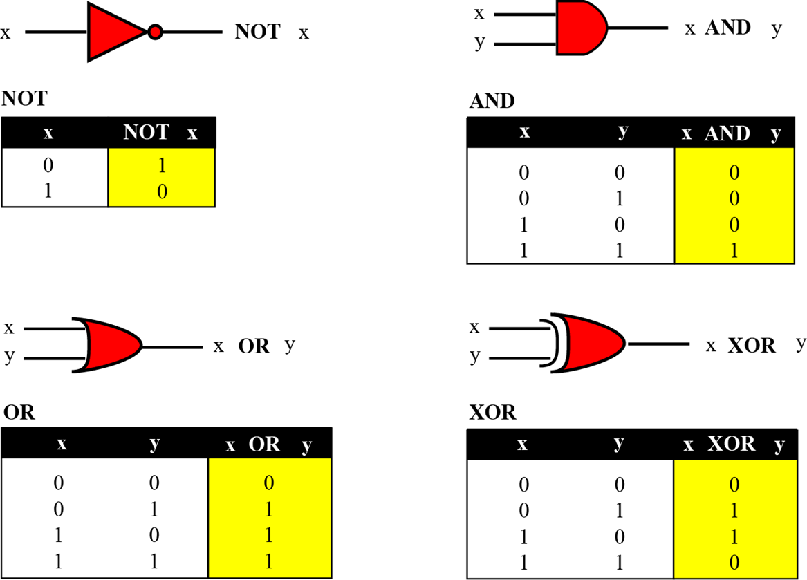
1. Introduction
Logic operations refer to those operations that apply the same basic operation on individual bits of a pattern, or on two corresponding bits in two patterns.
A logic operation at the pattern level is n logic operations, of the same type, at the bit level where n is the number of bits in the pattern.
A bit can take one of the two values: 0 or 1. If we interpret 0 as the value false and 1 as the value true,

Slide 37
2. The NOT operator
The NOT operator is a unary operator: it takes only one input. The output bit is the complement of the input.
Example 3.3 Use the NOT operator on the bit pattern 10011000.
Solution The solution is shown below. Note that the NOT operator changes every 0 to 1 and every 1 to 0.
Notes:
NOT ; trả kết quả đối

Slide 38
3. The AND operator
The AND operator is a binary operator: it takes two inputs. The output bit is 1 if both inputs are 1s and the output is 0 in the other three cases.
Example 3.4 Use the AND operator on the bit patterns 10011000 and 00101010.
Solution The solution is shown below. Note that only one bit in the output is 1, where both corresponding inputs are 1s.
Notes:
Bất kì bit nào AND với 0 ĐỀU = 0

Slide 39
4. The OR operator
The OR operator is a binary operator: it takes two inputs. The output bit is 0 if both inputs are 0s and the output is 1 in other three cases.
Example 3.5 Use the OR operator on the bit patterns 10011001 and 00101110.
Solution The solution is shown below. Note that only one bit in the output is 0, where both corresponding inputs are 0s.
Notes:
OR : 1 trong 2 bit là đúng ( =1 ) thì kết quả trả về 1

Slide 40
5. The XOR operator
The XOR operator is a binary operator like the OR operator, with only one difference: the output is 0 if both inputs are 1s.
Example 3.6 Use the XOR operator on the bit patterns 10011001 and 00101110.
Solution
The solution is shown below. Compare the output in this example with the one in Example 4.5. The only difference is that when the two inputs are 1s, the result is 0 (the effect of exclusion).
Notes:
Giống OR nhưng nếu 2 giá trị đầu vào giống nhau thì kết quả = 0
Phép toán Logic hỗ trợ cho ALU làm phép toán cộng

Slide 41
2 - Shift Operations
Notes:
Phép toán tịnh tuyến ( phép dịch bit )

Slide 42
1. Introduction
Shift operations move the bits in a pattern, changing the positions of the bits. They can move bits to the left or to the right.
We can divide shift operations into two categories: logical shift operations and arithmetic shift operations.
Logical Shift Operations A logical shift operation is applied to a pattern that does not represent a signed number.
The reason is that these shift operations may change the sign of the number that is defined by the leftmost bit in the pattern. We distinguish two types of logical shift operations, as described below:
Logical shift
Logical circular shift (Rotate)
Notes:
Phép dịch Logic => unsigned number ( các số ko dấu ~ số ko âm : >= 0 )
Phép dịch số học => signed number

Slide 43
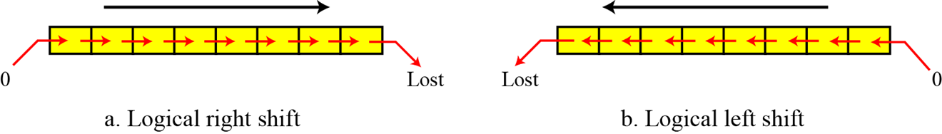
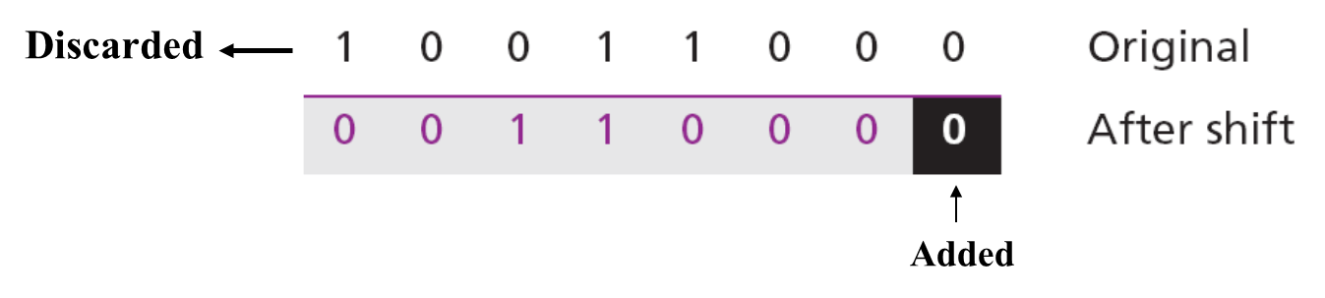
2. Logical Right/Left Shift Operations
Figure 3.5 Logical shift operations
Example 3.7
Use a logical left shift operation on the bit pattern 10011000.
Solution
The leftmost bit is lost and a 0 is inserted as the rightmost bit.
Notes:
Dịch phải logic : thêm 0 vào trái -> Ý nghĩa: chia 2 lấy phần nguyên ( % ) .Chứng minh bằng cách tính kết quả hệ thập
Dịch trái logic : them 0 vào phải

Slide 44
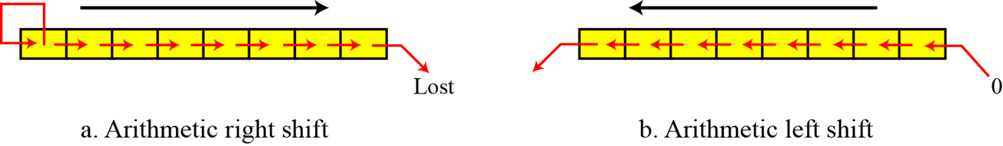
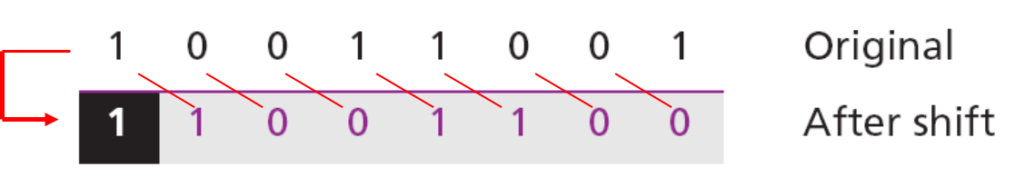
3. Logical Right/Left Circular Shift Operations
Figure 3.6 Logical shift operations
Example 3.8
Use a circular left shift operation on the bit pattern 10011000.
Solution
The solution is shown below. The leftmost bit is circulated and becomes the rightmost bit.
Notes:
Circular Shift ( dịch bit vòng tròn Trái /Phải )

Slide 45
4. Arithmetic Shift Operations
Arithmetic shift operations assume that the bit pattern is a signed integer in two’s complement format. Arithmetic right shift is used to divide an integer by two, while arithmetic left shift is used to multiply an integer by two.
Figure 3.7 Arithmetic shift operations
Example 3.9
Use an arithmetic right shift operation on the bit pattern 10011001.
The pattern is an integer in two’s complement format.
Solution
The solution is shown below. The leftmost bit is retained and also
copied to its right neighbor bit.
Notes:
Dịch chuyển số học GIỐNG dịch chuyển logic khác chỗ Nhân đôi số đầu tiên ( vd 1 -> 11 , 0 -> 00 )
ALU ( đơn vị : Unit , tính toán số học : Arithmetic và Logic )

Slide 46
3 - Arithmetic operations

Slide 47
Introduction
Arithmetic operations involve adding, subtracting, multiplying and dividing. We can apply these operations to integers and floating-point numbers.
Arithmetic Operations on Integers
All arithmetic operations such as addition, subtraction, multiplication and division can be applied to integers. Although multiplication (division) of integers can be implemented using repeated addition (subtraction), the procedure is not efficient.
Two’s Complement Integers
When the subtraction operation is encountered, the computer simply changes it to an addition operation, but makes two’s complement of the second number. In other words:
Bù 1 của B
Bù 2 của B

Slide 48
Addition and subtraction of integers in two’s complement
Figure 3.8 Addition and subtraction of integers

Slide 49
Addition and subtraction of integers in two’s complement (cont)
Example 3.10
Two integers A and B are stored in two’s complement format. Show how B is added to A.
A = (00010001)₂ B = (00010110)₂
Solution
The operation is adding. A is added to B and the result is stored in R. (+17) + (+22) = (+39).

Slide 50
Addition and subtraction of integers in sign-and-magnitude
Figure 3.8 Addition and subtraction of integers in sign-and-magnitude

Slide 51
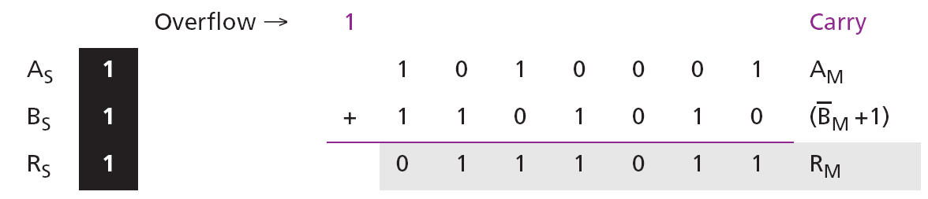
Addition and subtraction of integers in sign-and-magnitude (cont)
Example 3.11
Two integers A and B are stored in sign-and-magnitude format. Show how B is subtracted from A.
A = (1 1010001)₂ B = (1 0010110)₂
Solution
The operation is subtracting: S_{B} = S_{B}. S = A_{S} XOR B_{S} = 1, R_{M} = A_{M} + (B_{M} +1). Since there is an overflow, the value of R_{M} is final. The sign of R is the sign of A. (−81) − (−22) = (−59).

Slide 52
Arithmetic Operations on Reals
All arithmetic operations such as addition, subtraction, multiplication and division can be applied to reals stored in floating-point format.
Multiplication of two reals involves multiplication of two integers in sign-and-magnitude representation.
Division of two reals involves division of two integers in sign-and-magnitude representations
Addition and Subtraction of Reals
Addition and subtraction of real numbers stored in floating-point numbers is reduced to addition and subtraction of two integers stored in sign-and-magnitude (combination of sign and mantissa) after the alignment of decimal points. Figure 4.8 shows a simplified version of the procedure (there are some special cases that we have ignored).

Slide 53
Addition and subtraction of reals in floating-point format
Figure 3.9 Addition and subtraction of integers in floating-point format

Slide 54
Addition and subtraction of reals in floating-point format (cont)
Example 3.11
Show how the computer finds the result of (+5.75) + (−7.0234375) = − 1.2734375.
Solution
These two numbers can be stored in floating-point format, as shown below:
De-normalization results in:

